Slide 1
caTRIP F2F
Problem Scenarios
R. Dash

Slide 2
General Categories
Outcomes analysis
Access to patient records
Facilitating clinical trial interactions

Slide 3
Outcomes Analysis
Drawing associations between events and predefined end-points, usually over a large cohort of patients

Slide 4
caTrip
Outcomes Analysis
Events and end-points will have to be defined as a CDE and captured
  Clinical: adverse events, treatment, dosage, weight, height, sex, age
  Pathology: biopsy results, tumor size, glucose level, white blood cell count
  Wet lab: gene expression, proteomics

Slide 5
Problem Scenario 1
New patient with “invasive lobular breast cancer”
Risks for recurrence?
  With surgery alone
  With chemotherapy
  With radiation
  With combined treatments in various sequences

Slide 6
Problem Scenario 1
Invasive lobular carcinoma
  Family history
    Of breast cancer
    Of “unrelated” cancer
    Even if cytogenetic abnormalities documented, does that confer increased risk?
    Of “unrelated” genetic conditions (e.g. sickle cell anemia)

Slide 7
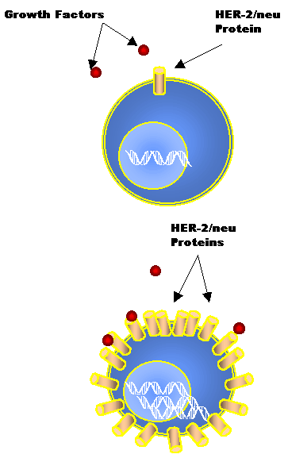
Problem Scenario 1
Her-2/neu oncogene overexpression
“Never” happens in lobular carcinomas
How to predict behavior?
Will it respond to herceptin?

Slide 8
Problem Scenario 1
Follow Up Questions
What about other breast neoplasms that are less well studied?
What about men who develop breast cancer?
What about very young women that develop breast cancer?
  If a woman carries a defective BRCA1 or BRCA2 gene, she may have a 35 to 85 percent chance of developing breast cancer in her lifetime. Why such a wide range?
  What about men?

Slide 9
Problem Scenario 2
Access to patient records
  Multiple hospitals in a health system
  Travel across health systems
  Travel across state or out of the country
    Tougher issue: language translation
Can web-services based system address the issue of access?
Can data be provided in a manner helpful for remote patient care?

Slide 10
Problem Scenario 2
Patient from NY in motor vehicle accident in UK.
  Blood type?
  Bleeding disorder?
  Diabetes?
    Did they pass out from insulin overdose and crash?
  Hypertension?
  Genetic disorder?

Slide 11
Problem Scenario 2
Patient newly diagnosed with malignancy and referred to tertiary care / academic facility
  How does data transfer occur currently?
  How is medical data reviewed for accuracy?
  How can a translational system “travel” with the patient?

Slide 12
Problem Scenario 3
Clinical Research Trial Interaction
  Same patient with new malignancy…
  How to find out about local, state, national (international?) ongoing clinical trials?
  How to find out the criteria for which the patient may be eligible?
  Does the patient really have to “move” to be treated?
  Can a translational system extend the reach of investigators to remote settings?

Slide 13
Problem Scenario 3
Translational system application
  Access to eligibility criteria
  Matching patients based on CDE in system to clinical trials
  Allowing access to consented patient data to investigators
  Allowing remote treatment and continued follow up by (remote) principal investigators
  Facilitating collaboration between academic and community settings to help patients and enhance research simultaneously

Slide 14
Next Steps
Development of formal use cases.
Participation by multidisciplinary breast oncology group
  Medical oncologists
  Radiation oncologists
  Surgeons
  Radiologists
  Pathologists
  Nurses and clinical research coordinators

